Slide 1
SQL Portfolio : TechCorp
Rafi Widyansyah

Slide 2
Implementing SQL : TechCorp
TechCorp is an e-commerce company that focuses on selling electronic products such as laptops, smartphones, and accessories. TechCorp also provides customer support services to assist customers with technical issues and questions regarding the products being sold.

Slide 3
Dataset Schema
The “TechCorp” database consists of 6 tables :
Table of product (Products): stores information about products.
Table of customers (Customers): stores information about customers.
Table of orders (Orders): information about customers’ order.
Table of order details (OrderDetails): information about every detail of each order
Table of employees (Employees): information about TechCorp employees.
Table of support ticket (SupportTickets): information about every customer support ticket.

Slide 4
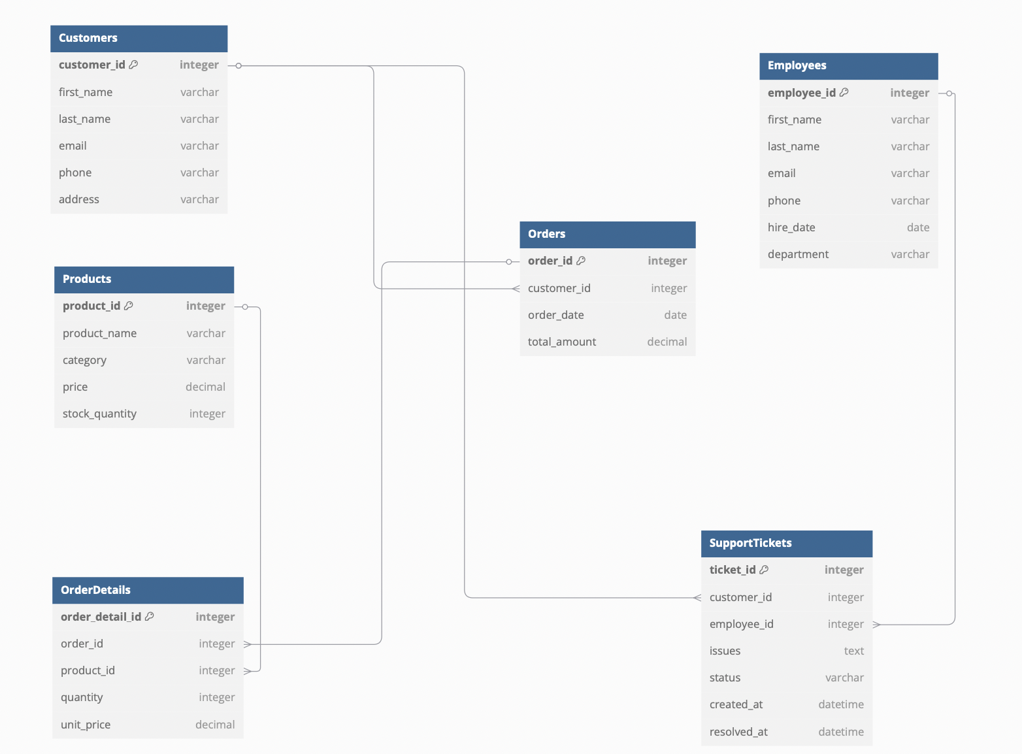
Database Diagram

Slide 5
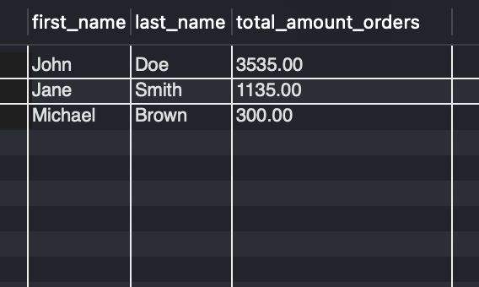
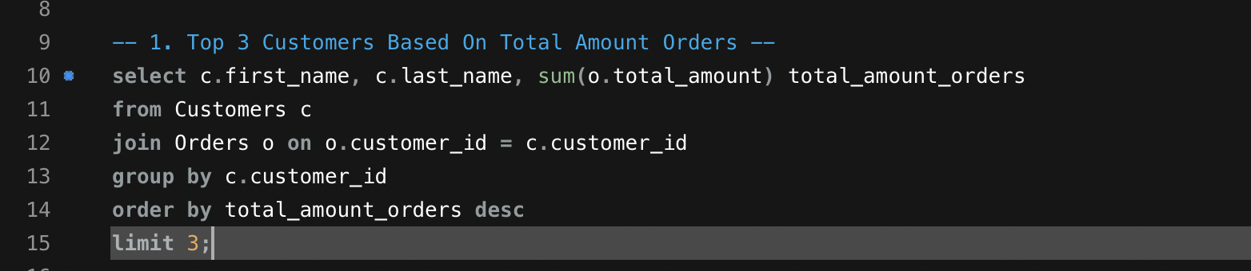
Top 3 Customers Based on Total Amount Order

Slide 6
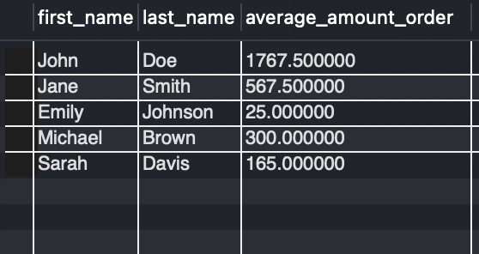
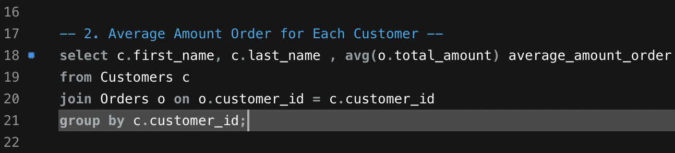
Average amount order for each customers

Slide 7
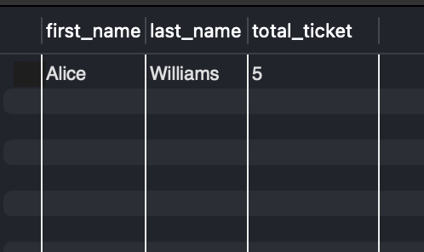
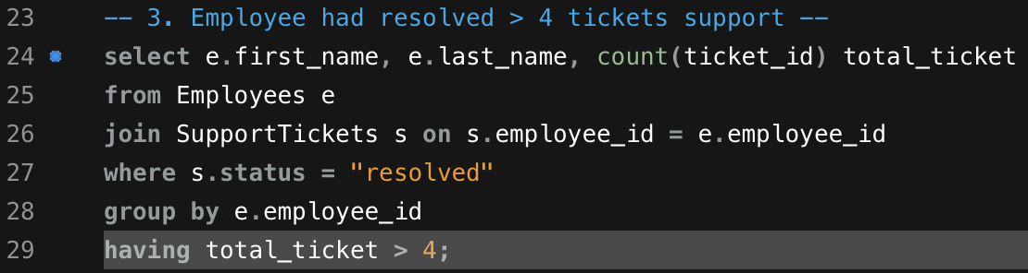
Employee who resolved more than 4 tickets

Slide 8
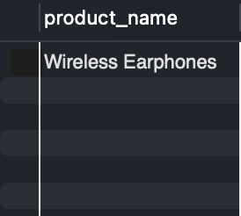
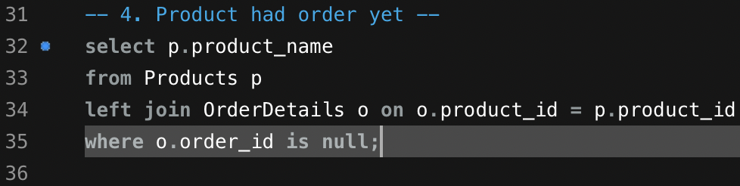
Product had order yet

Slide 9
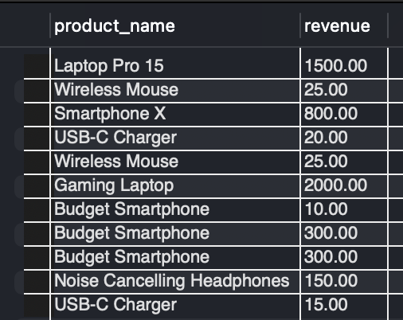
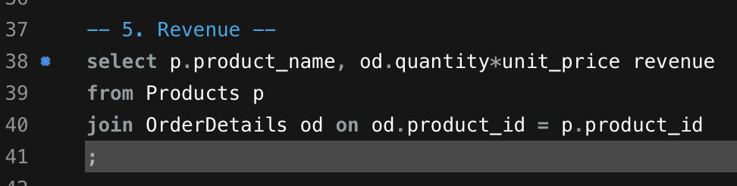
Revenue of Each Product

Slide 10
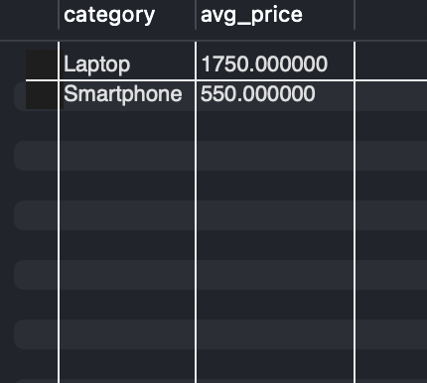
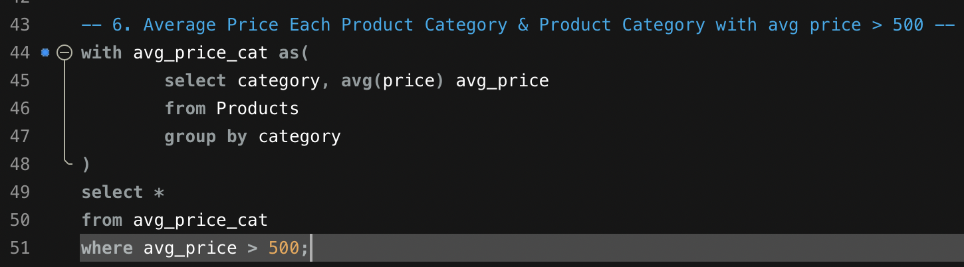
Average price of each category product & category product with average price > 500 USD

Slide 11
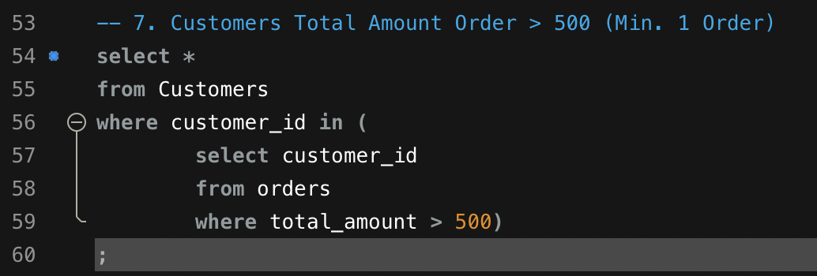
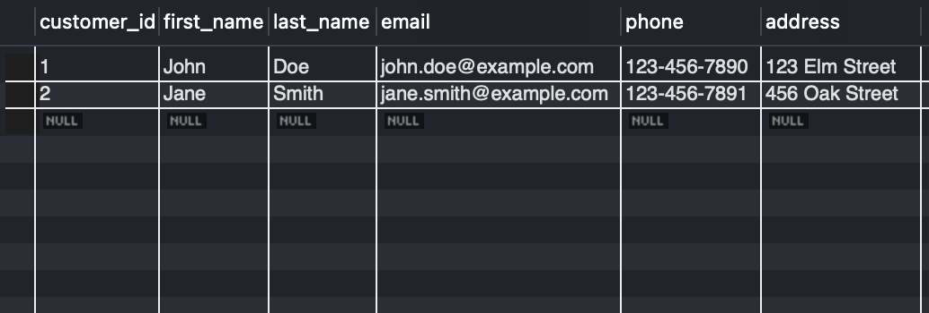
Customer with total amount order > 500 USD

